Slide 1
COMP1860 Building our Digital World: Computer Systems & Architecture
S1.W4.L3: Week 1-4 Summary
Dr James Dyer

Slide 2
Week 1: Key Takeaways
Architecture & Organisation
Structure & Function
  Hierarchical structure
  Structure of single core and multicore computers
  Principal functions of computer
Principal components of computer
  Logic gates & memory cells
  Moore’s Law
Von Neuman & Harvard architectures
The following you should know about but will not be examined by me:
  System bus
  Instruction Sets
    CISC vs RISC
  Embedded Systems
    Types of embedded system IC (microcontroller, SoC, ASIC, DSP)
  OS
  Parallelism
    Revisited in more detail in S2

Slide 3
Week 2: Key Takeaways
Binary arithmetic
Conversion
  Decimal to binary
  Hexadecimal to binary
  And vice versa
Integer representations
  Unsigned
  Sign-magnitude
  Two’s complement
    Arithmetic
  BCD
Fixed point representation
  Qm.n format
Floating point representation
  IEEE754 half and single precision formats
Byte order
  Big endian
  Little endian

Slide 4
Week 3: Key Takeaways
Text Representation
  ASCII
  UTF-8
Image Representation
  Pixel maps
  Colour models
Other non-numeric
  Arrays, Strings (arrays of characters), Boolean
  Records
    Word/Byte alignment
Boolean Logic
  Logic operators
  Truth tables
  DNF/CNF
Logic circuits

Slide 5
Week 4: Key Takeaways
Combinational logic
  Multiplexer
  Decode
  Adder
Boolean algebraic laws
NAND gates
Karnaugh maps

Slide 6
What you don’t need to remember
Dates
Models of historical computers/chips
UTF-8 bit formats
Word/byte alignments of data types

Slide 7
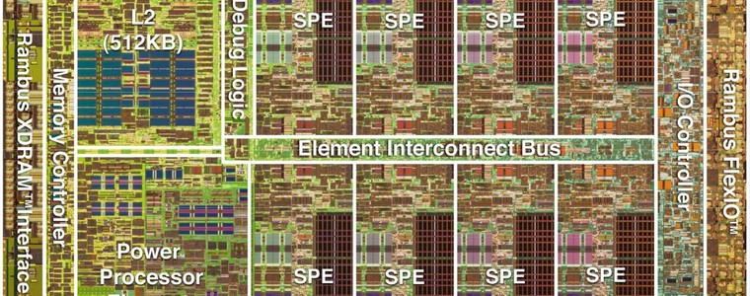
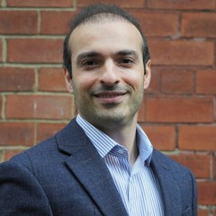
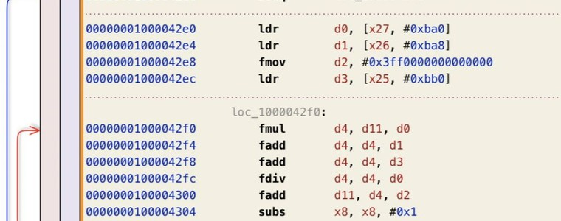

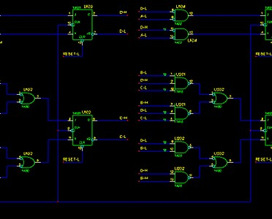
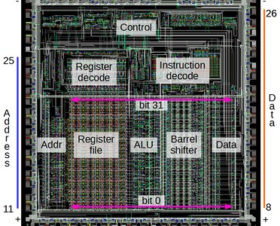
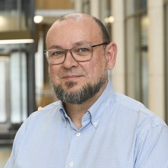
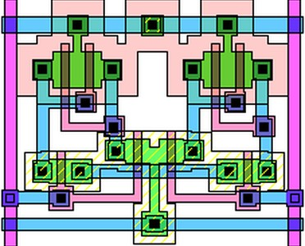
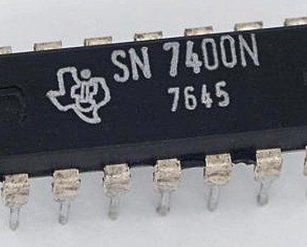

COMP1860 · MODULE OVERVIEW
Computer Systems & Architecture
Build a computer from the ground up — from logic gates to parallel architectures, one layer at a time.
LAYER 04
Memory, I/O & parallelism
Dr Arash Bozorgchenani
memory hierarchy · I/O · interconnects · parallel architectures
SEMESTER 2
LAYER 03
Assembly & virtual machines
Dr Massimiliano Fasi
assembly language · virtual machines
LAYER 02
Processor design
Prof Leandro Soares Indrusiak
hardware description language · simulation · CPU architecture · instruction sets
ABSTRACTION
SEMESTER 1
LAYER 01
Digital logic
Dr James Dyer
digital data representation · Boolean algebra · digital circuits
Image credits: CPU die photo — Ken Shirriff; SN7400 chip — Texas Instruments (via Wikimedia Commons); Cell processor die — IBM; ARM assembly listing — The Eclectic Light Company.
Notes:
The module climbs the abstraction stack. Semester 1: James Dyer covers data representation, Boolean algebra and digital circuits; Leandro Soares Indrusiak covers HDL, simulation, CPU architecture and instruction sets. Semester 2: Massimiliano Fasi covers assembly and virtual machines; Arash Bozorgchenani covers memory, I/O, interconnects and parallelism.

